Slide 1
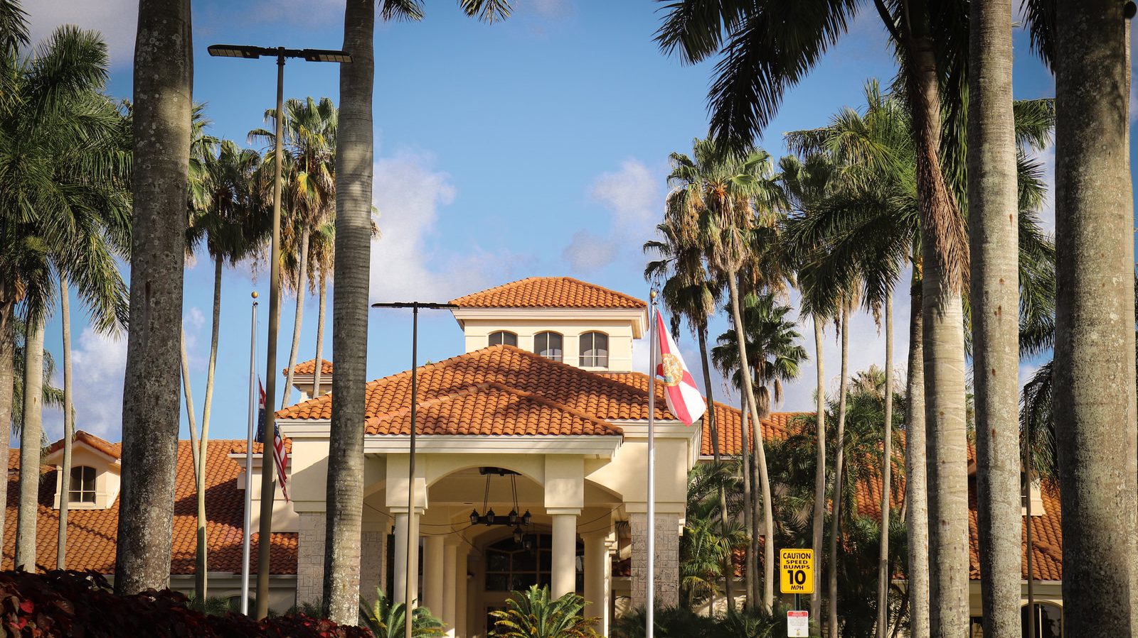
PEDRO GOMEZ-FACCIO
Marketing that earns attention
and moves the business.
SELECTED PROPERTY MANAGEMENT + HOSPITALITY WORK
Commercial strategy · brand systems · digital experience · marketplace growth
Prepared for Marketing Director consideration
Notes:
[Sources]
- /Users/faccio/Desktop/Portfolio/IMG_1097.jpeg — user-provided property image

Slide 2
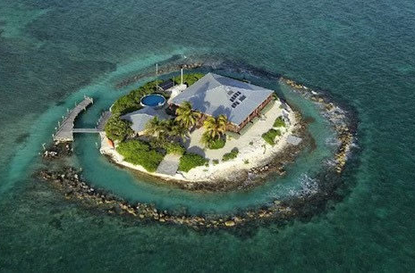
PROPERTY APPRAISAL
East Sister Rock: a premium asset translated into a defensible value story
The appraisal combined property detail, market context, income evidence, and comparable-sales logic into a client-ready 37-page report.
$11M
2,304
INDICATED VALUE
MAIN RESIDENCE SQ FT
Sales comparison approach
Three bedrooms · two baths
DISTINCTIVE PROPERTY CHARACTERISTICS
Private island setting with dock access
Pool, guest house, and resort-style outdoor spaces
Solar and wind systems supporting island operations
PEDRO GOMEZ-FACCIO / MARKETING PORTFOLIO
02
Notes:
[Sources]
- /Users/faccio/Desktop/Portfolio/output/East Sister Rock Appraisal Report.pdf — East Sister Rock appraisal report, 37 pages
- /Users/faccio/Pictures/Photos Library.photoslibrary/resources/derivatives/masters/B/B068E20A-8B75-4698-A328-BF82D5E18C63_4_5005_c.jpeg — user-provided property photograph

Slide 3
PROPERTY APPRAISAL
The report made the economics visible — not just the property
Key operating evidence was surfaced alongside the valuation so decision-makers could assess both asset quality and income potential.
$225,916
$167,954
$9,609
DOCUMENTED RENTAL INCOME
ANNUAL OPERATING INCOME
NET MONTHLY CASH FLOW
Partial-year total, January 3 through June 5
Based on the report's operating statement
After housing expense in the report model
VIEWABLE DELIVERABLE
Full East Sister Rock Appraisal Report
VIEW FULL REPORT
The complete 37-page PDF is included with this portfolio and available as a standalone download in the web version.
PEDRO GOMEZ-FACCIO / MARKETING PORTFOLIO
03
Notes:
[Sources]
- /Users/faccio/Desktop/Portfolio/output/East Sister Rock Appraisal Report.pdf — rental history and operating statement

Slide 4
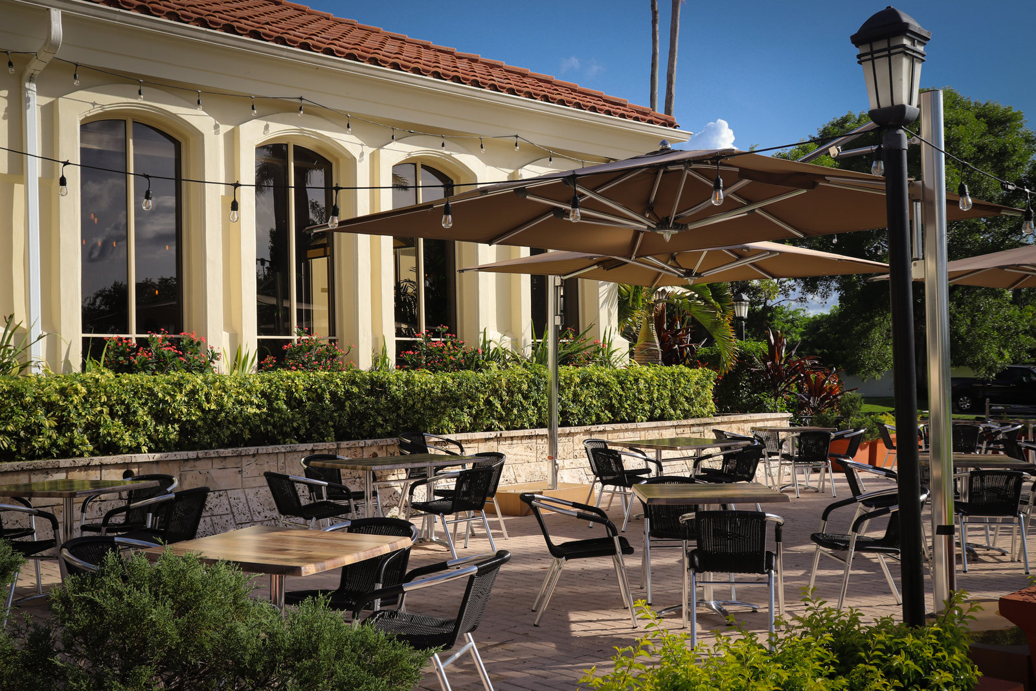
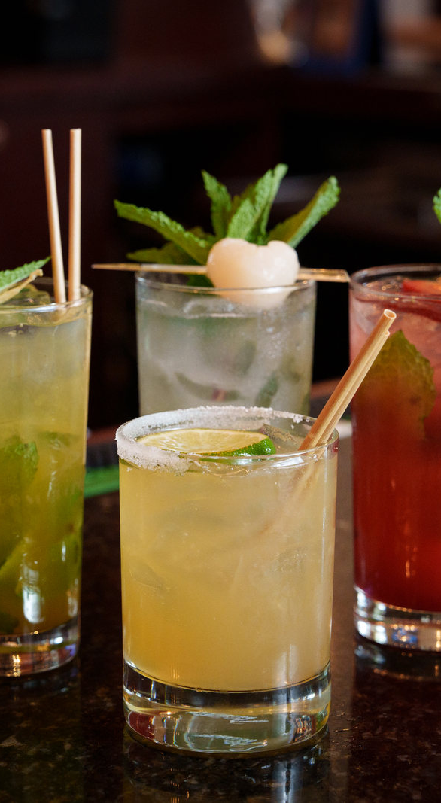
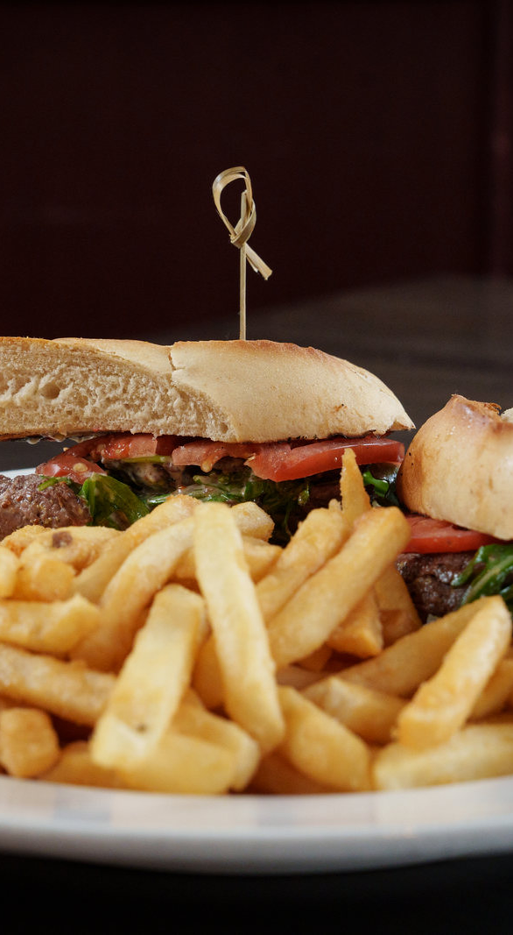
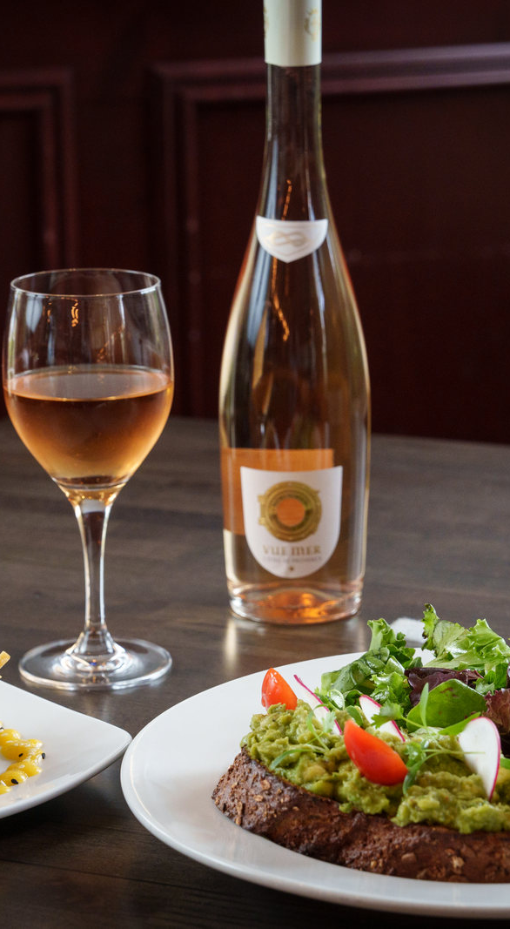
HOSPITALITY PORTFOLIO
A property experience becomes a brand when every guest touchpoint connects
Venue, food, beverage, digital merchandising, and campaign creative were treated as one connected operating system.
COCKTAIL DIRECTION
MENU MERCHANDISING
GUEST EXPERIENCE
D1 · PROPERTY + RESTAURANT EXPERIENCE
PEDRO GOMEZ-FACCIO / MARKETING PORTFOLIO
04
Notes:
[Sources]
- /Users/faccio/Desktop/Portfolio/D1.jpeg
- /Users/faccio/Desktop/Portfolio/BackyardKitchenandBar_2023-24.jpg
- /Users/faccio/Desktop/Portfolio/BackyardKitchenandBar_2023-69.jpg
- /Users/faccio/Desktop/Portfolio/BackyardKitchenandBar_2023-181.jpg

Slide 5
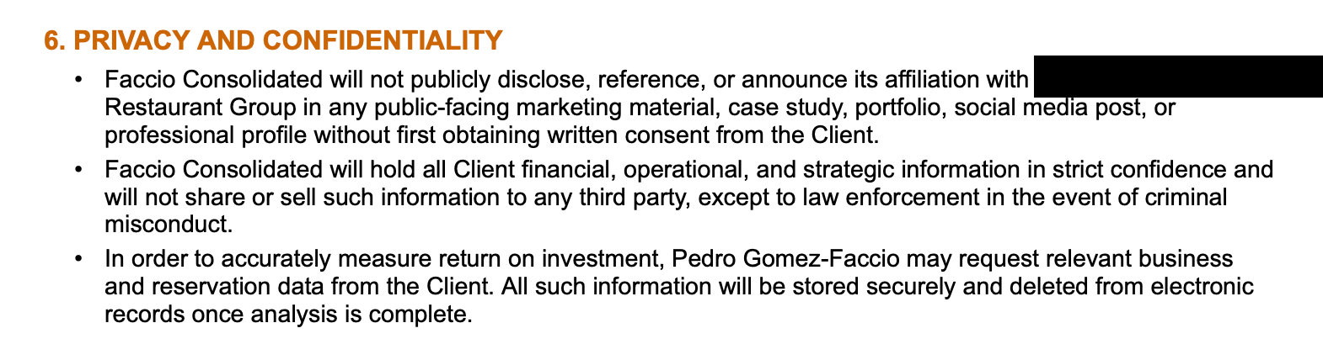
CONSENT AND CONFIDENTIALITY
Only consented work is included — privacy is part of the operating discipline
To deliver quickly and responsibly, this selection is limited to property-management and hospitality clients who expressly consented to sharing work and results.
PRIVACY CLAUSE EXCERPT
Written client consent before public-facing portfolio use
Financial, operational, and strategic information held in strict confidence
Relevant business data stored securely and deleted after analysis
Names, dates, platform labels, and private identifiers blurred where requested
PEDRO GOMEZ-FACCIO / MARKETING PORTFOLIO
05
Notes:
[Sources]
- /Users/faccio/Desktop/Portfolio/tmp/rebuild_assets/privacy/privacy-clause.png — user-provided contract excerpt

Slide 6
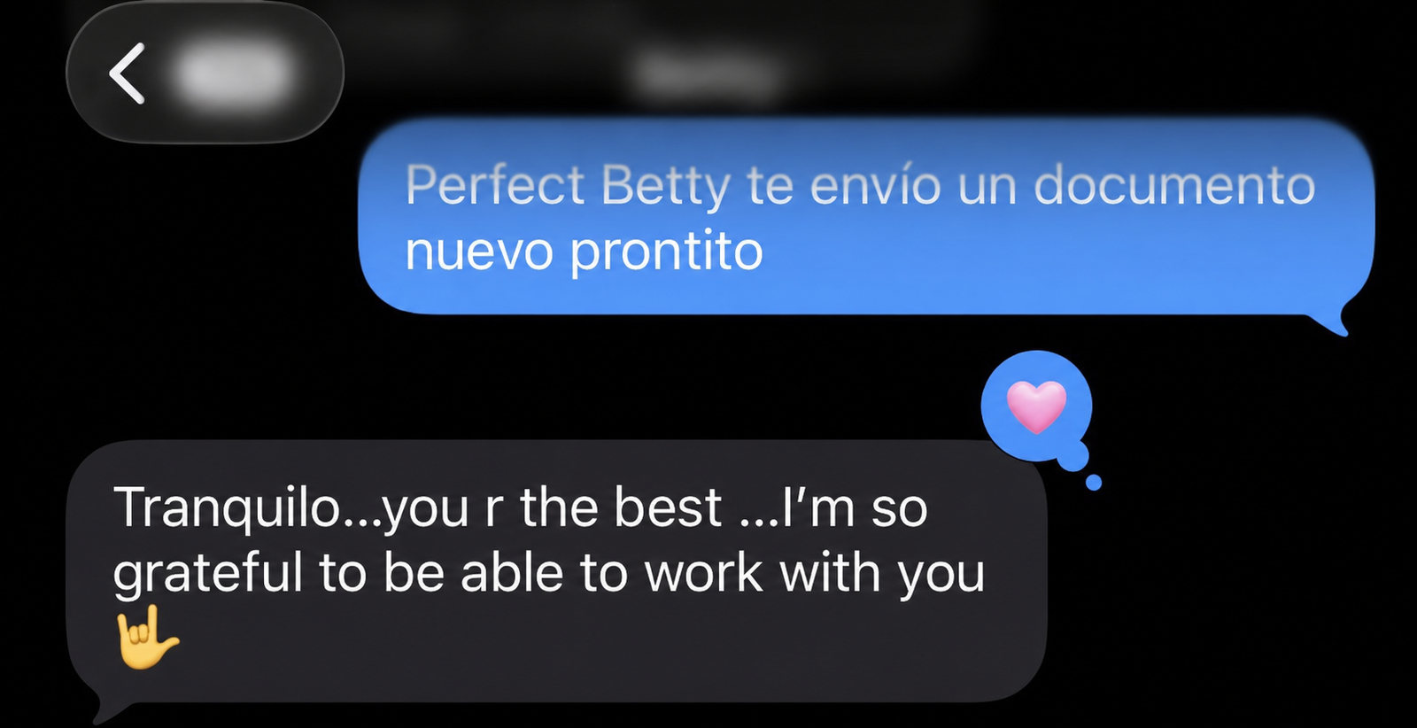

CLIENT FEEDBACK
Property-management and hospitality relationships built on trust
The work was not delivered as isolated creative — it was carried through in close partnership with client teams.
LONG-TERM RELATIONSHIP FEEDBACK
CLIENT PARTNERSHIP FEEDBACK
PEDRO GOMEZ-FACCIO / MARKETING PORTFOLIO
06
Notes:
[Sources]
- /Users/faccio/Desktop/Portfolio/tmp/rebuild_assets/testimonials/01-grateful.png — sanitized client message
- /Users/faccio/Desktop/Portfolio/tmp/rebuild_assets/testimonials/02-best-to-work-with.png — sanitized client message

Slide 7
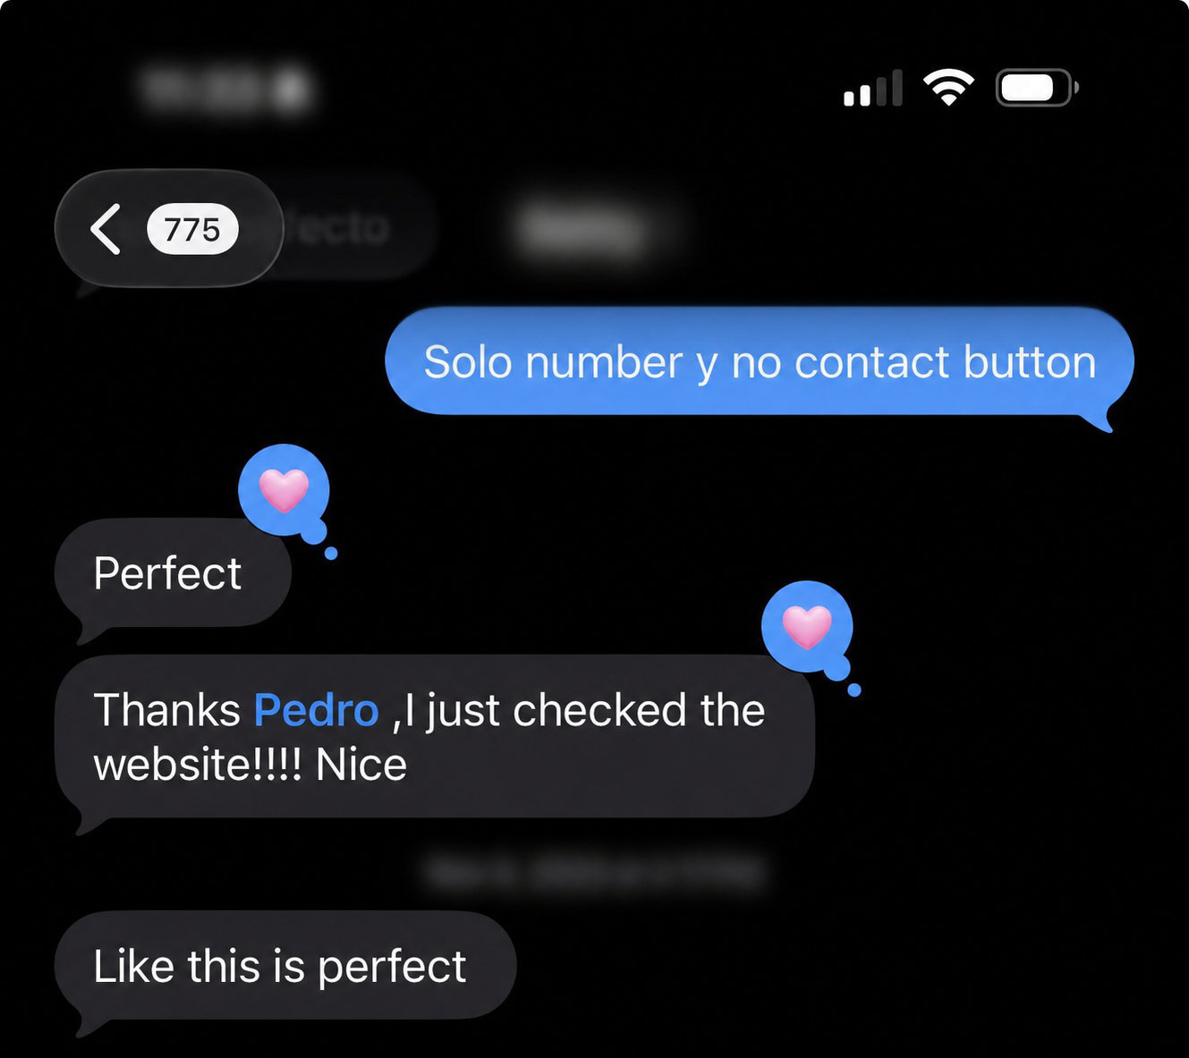
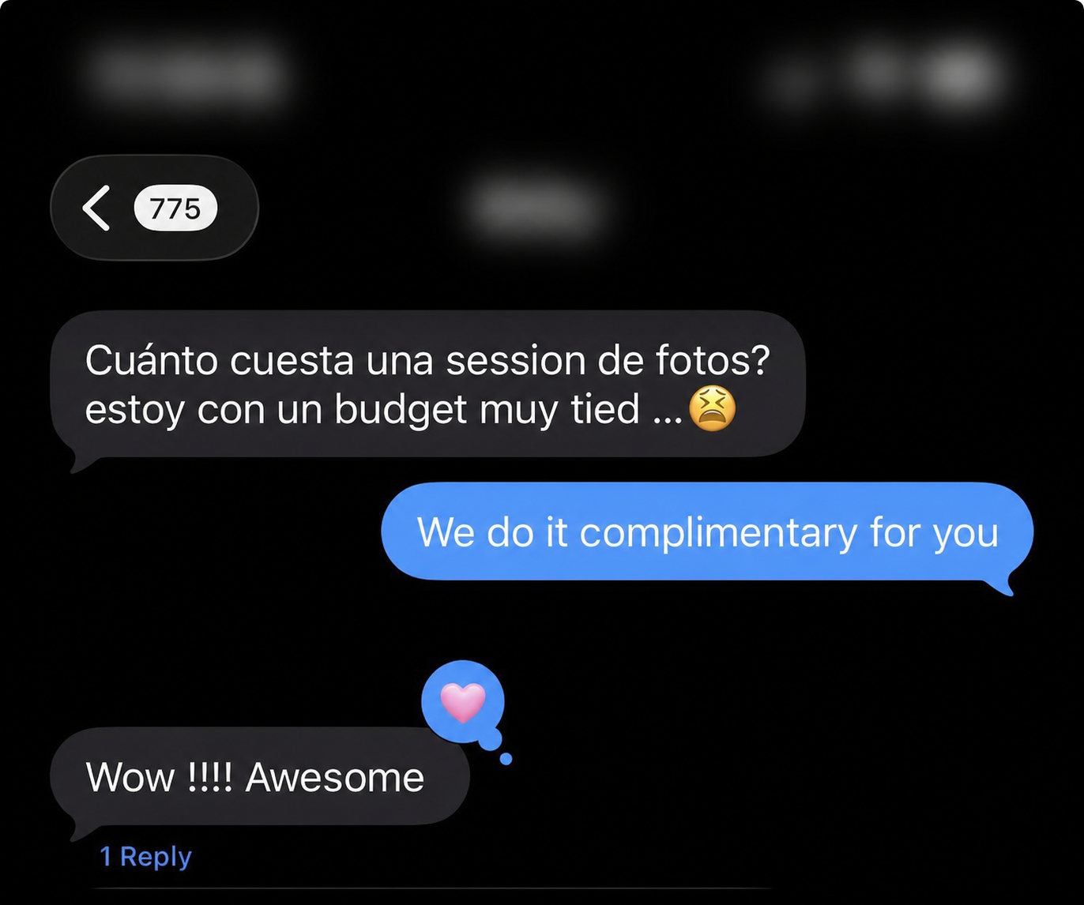
CLIENT FEEDBACK
Fast approvals came from understanding the business context
Feedback shows a consistent pattern: direct communication, rapid iteration, and creative that felt ready to use.
WEBSITE IMPLEMENTATION APPROVAL
PHOTOGRAPHY SUPPORT FEEDBACK
PEDRO GOMEZ-FACCIO / MARKETING PORTFOLIO
07
Notes:
[Sources]
- /Users/faccio/Desktop/Portfolio/tmp/rebuild_assets/testimonials/03-website-perfect.png — sanitized client message
- /Users/faccio/Desktop/Portfolio/tmp/rebuild_assets/testimonials/04-photo-awesome.png — sanitized client message

Slide 8
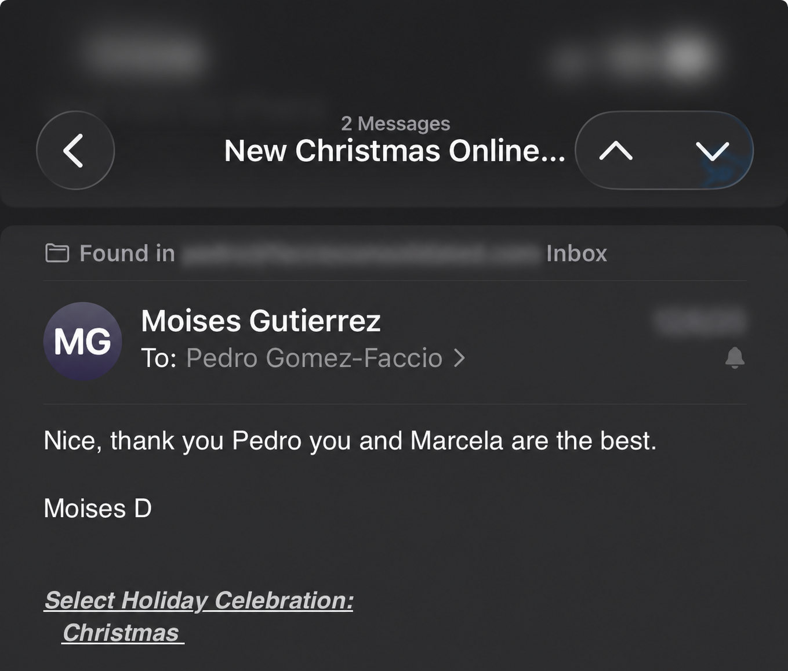
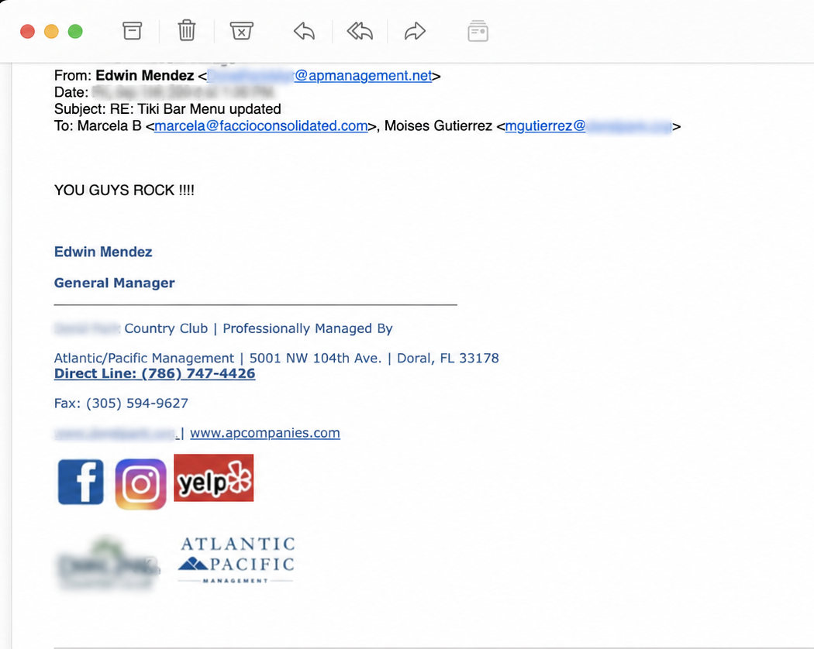
CLIENT FEEDBACK
The same standard carried from project delivery into daily client communication
These property-management and hospitality messages are shown at a readable size with requested private details removed.
EMAIL FEEDBACK
ATLANTIC / PACIFIC MANAGEMENT FEEDBACK
PEDRO GOMEZ-FACCIO / MARKETING PORTFOLIO
08
Notes:
[Sources]
- /Users/faccio/Desktop/Portfolio/tmp/rebuild_assets/testimonials/08-client-best-email.png — sanitized email
- /Users/faccio/Desktop/Portfolio/tmp/rebuild_assets/testimonials/09-you-guys-rock-email-cropped.png — sanitized email; apcompanies.com retained as requested

Slide 9
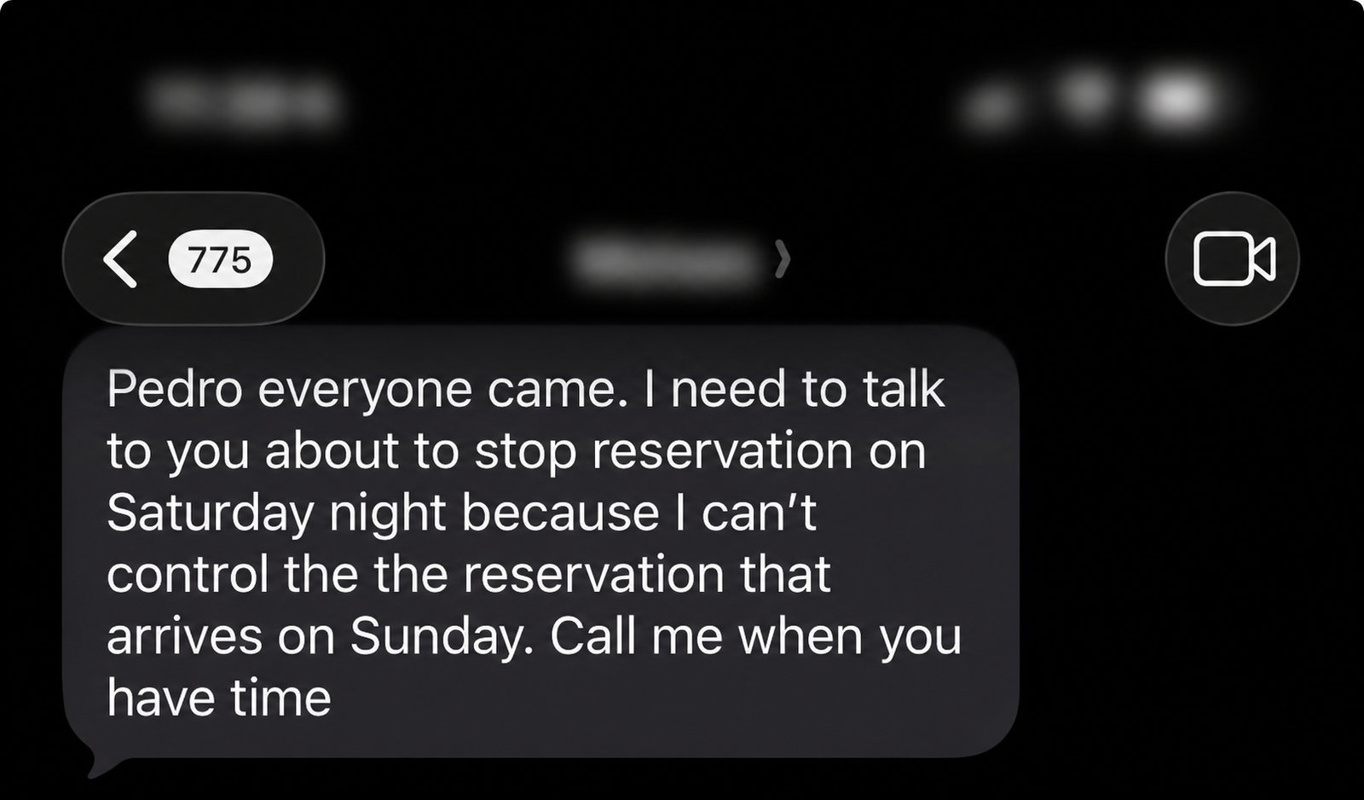
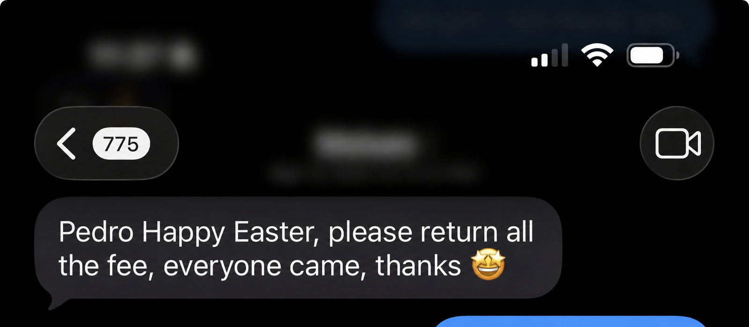
REPEATED RESULTS
Demand generation was visible in the client's own words
The clearest proof was operational: full events, reservation controls, and clients asking to stop additional demand.
DEMAND EXCEEDED OPERATING CAPACITY
HOLIDAY TURNOUT CONFIRMED
PEDRO GOMEZ-FACCIO / MARKETING PORTFOLIO
09
Notes:
[Sources]
- /Users/faccio/Desktop/Portfolio/tmp/rebuild_assets/testimonials/05-everyone-came.png — sanitized client message
- /Users/faccio/Desktop/Portfolio/tmp/rebuild_assets/testimonials/06-easter-everyone-came.png — sanitized client message

Slide 10
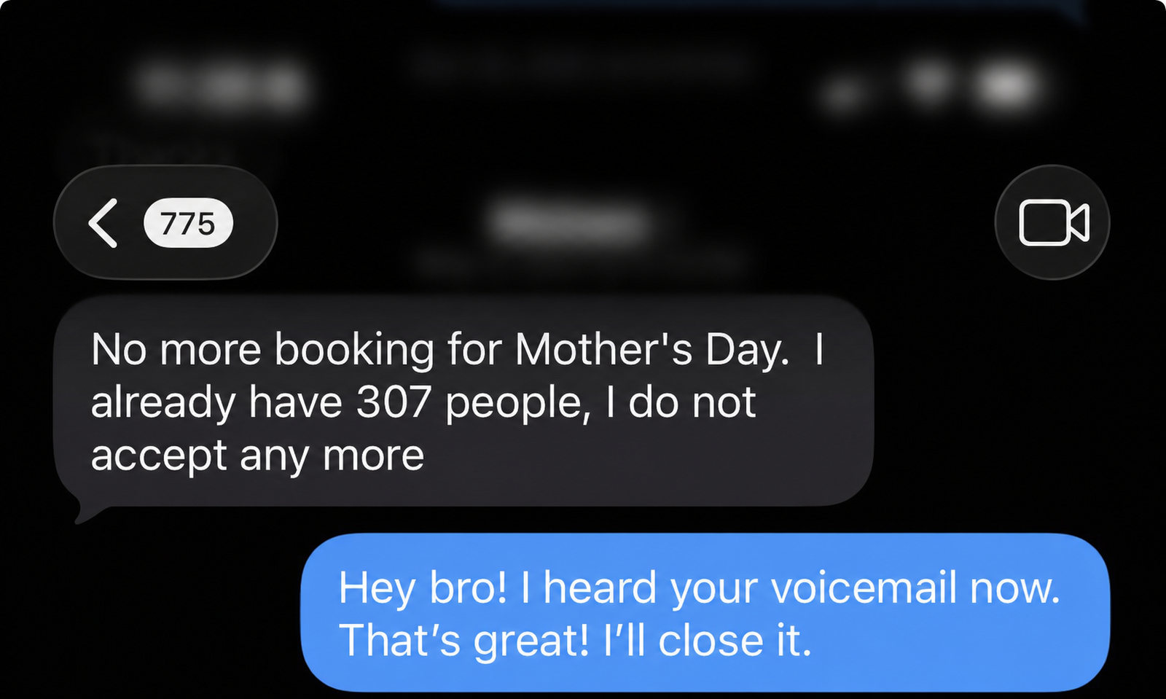
REPEATED RESULTS
307 Mother's Day reservations — then the client closed bookings
This is the practical endpoint of hospitality marketing: enough qualified demand that operations, not awareness, becomes the constraint.
307
RESERVATIONS REPORTED
Mother's Day capacity reached; no more bookings accepted
“I already have 307 people, I do not accept any more.”
CLIENT-REPORTED OPERATING RESULT
PEDRO GOMEZ-FACCIO / MARKETING PORTFOLIO
10
Notes:
[Sources]
- /Users/faccio/Desktop/Portfolio/tmp/rebuild_assets/testimonials/07-307-bookings.png — sanitized client message

Slide 11
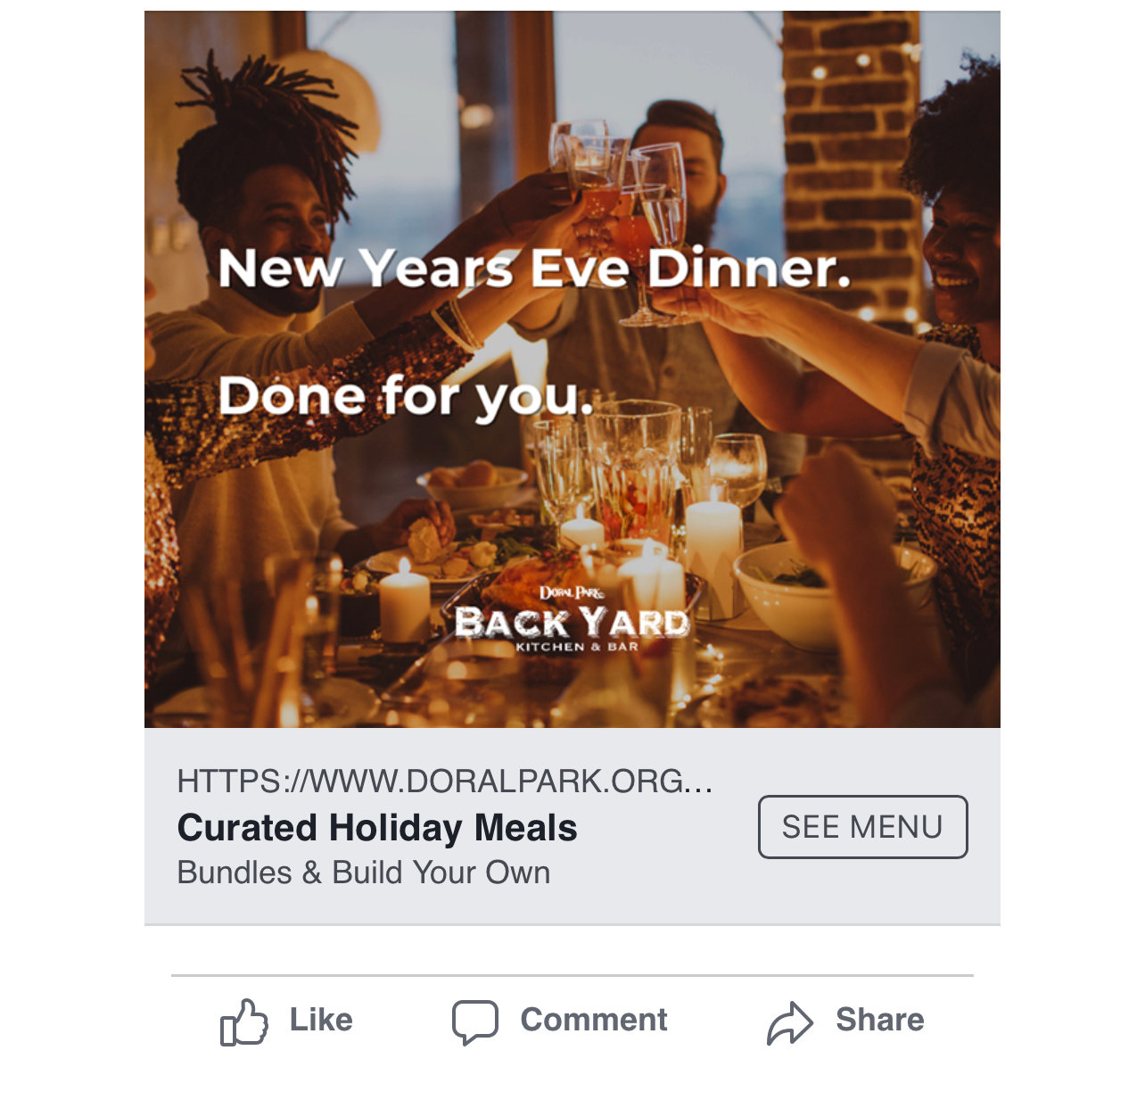
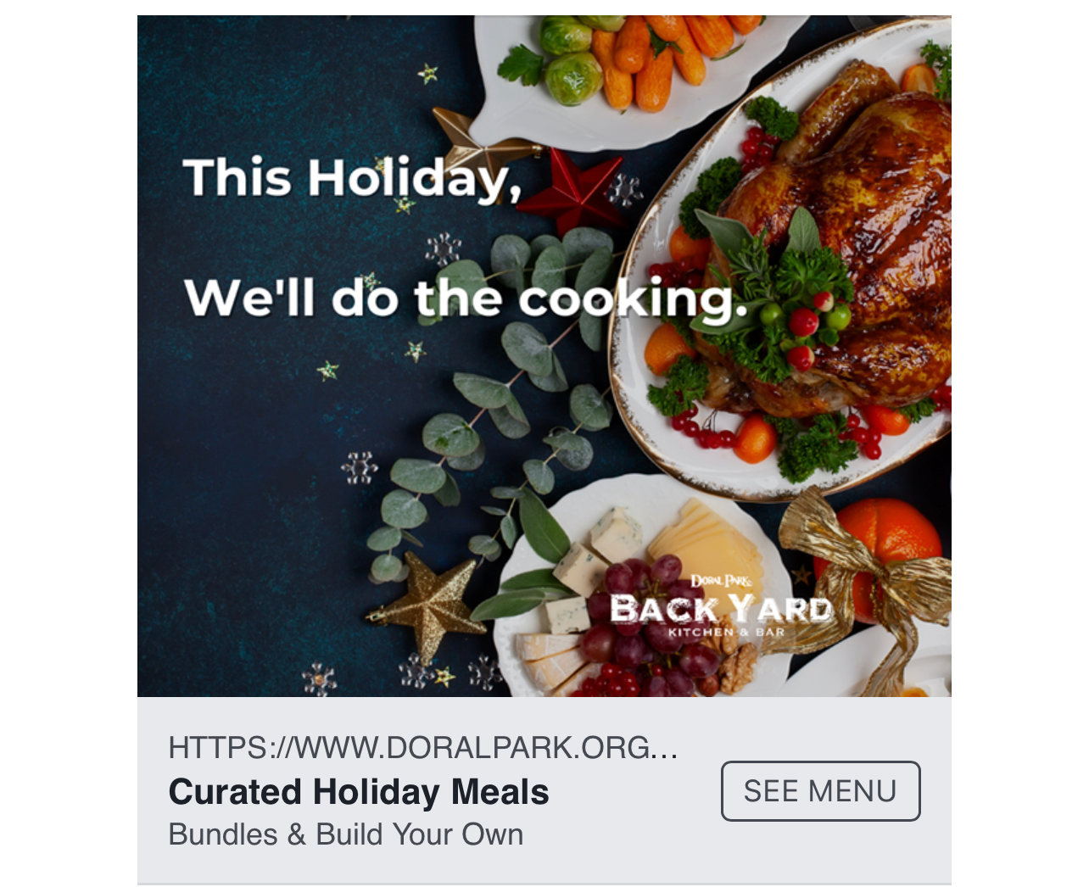
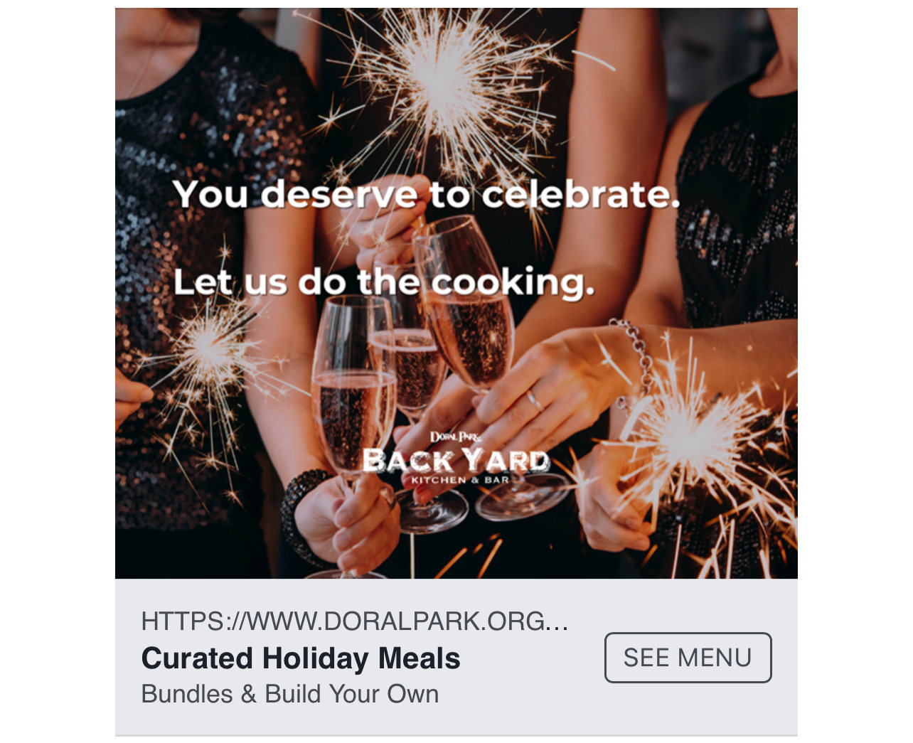
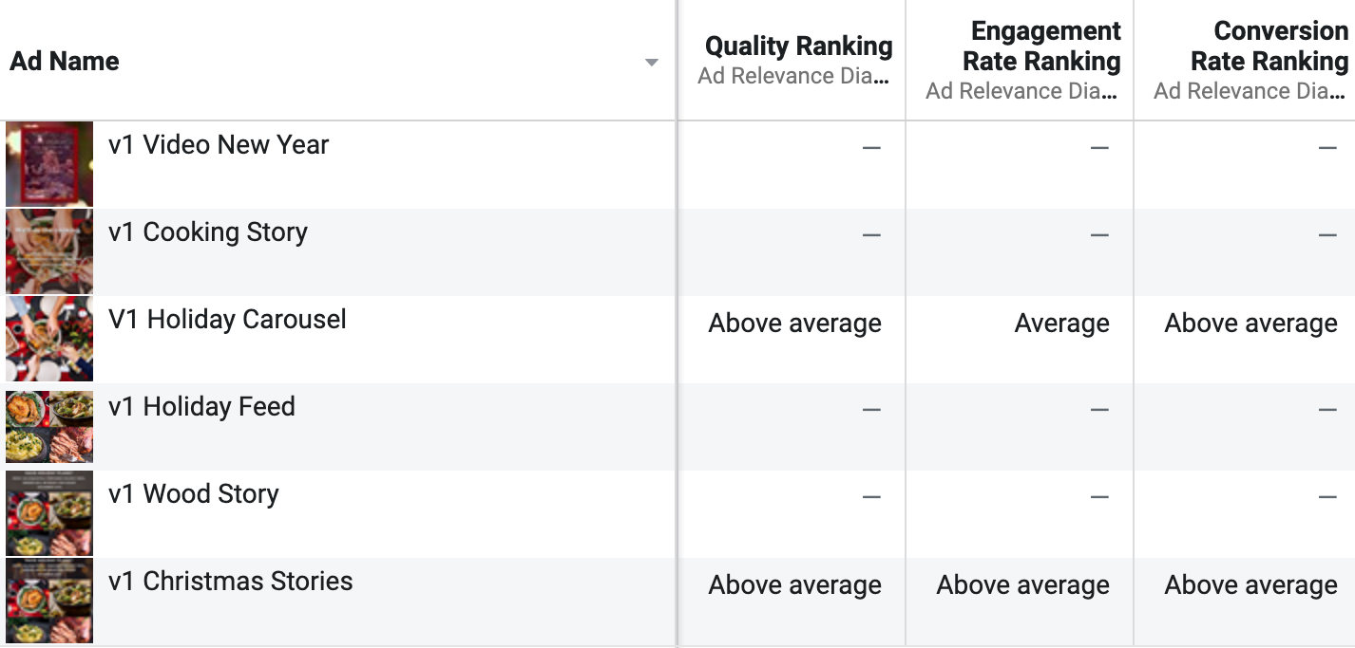
CAMPAIGN CREATIVE
Holiday concepts were adapted into a coherent multi-format campaign system
The same proposition was translated across feed, story, event, and conversion placements while protecting visual consistency.
THANKSGIVING OFFER
HOLIDAY CELEBRATION
NEW YEAR'S EVENT
DIGITAL PLACEMENT
PEDRO GOMEZ-FACCIO / MARKETING PORTFOLIO
11
Notes:
[Sources]
- Google Drive shared folder Holiday Ads
- /Users/faccio/Desktop/Portfolio/tmp/portfolio_build/holiday_ads/IMG_0301.jpeg
- /Users/faccio/Desktop/Portfolio/tmp/portfolio_build/holiday_ads/IMG_0302.jpeg
- /Users/faccio/Desktop/Portfolio/tmp/portfolio_build/holiday_ads/IMG_0304.jpeg
- /Users/faccio/Desktop/Portfolio/tmp/portfolio_build/holiday_ads/Screenshot_030951.png

Slide 12
CAMPAIGN CREATIVE
Creative decisions were tied to conversion and repeatable execution
Campaign work was organized around a clear offer, channel role, operating capacity, and the next measurable action.
01
02
03
04
Offer
Format
Friction
Result
What makes the guest act now?
How should the idea adapt by placement?
What blocks reservation or purchase?
What signal confirms the campaign worked?
“Everyone came.”
THE OPERATIONAL OUTCOME THE CLIENT REPORTED AFTER A HOLIDAY CAMPAIGN
PEDRO GOMEZ-FACCIO / MARKETING PORTFOLIO
12
Notes:
[Sources]
- /Users/faccio/Desktop/Portfolio/tmp/rebuild_assets/testimonials/06-easter-everyone-came.png
- Google Drive shared folder Holiday Ads

Slide 13
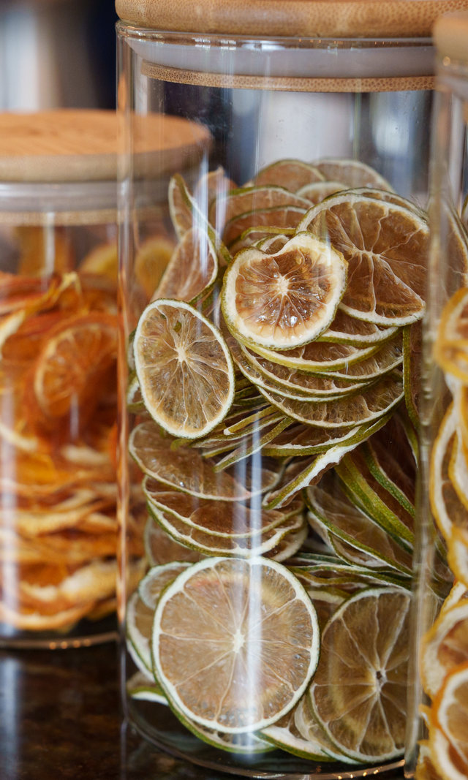

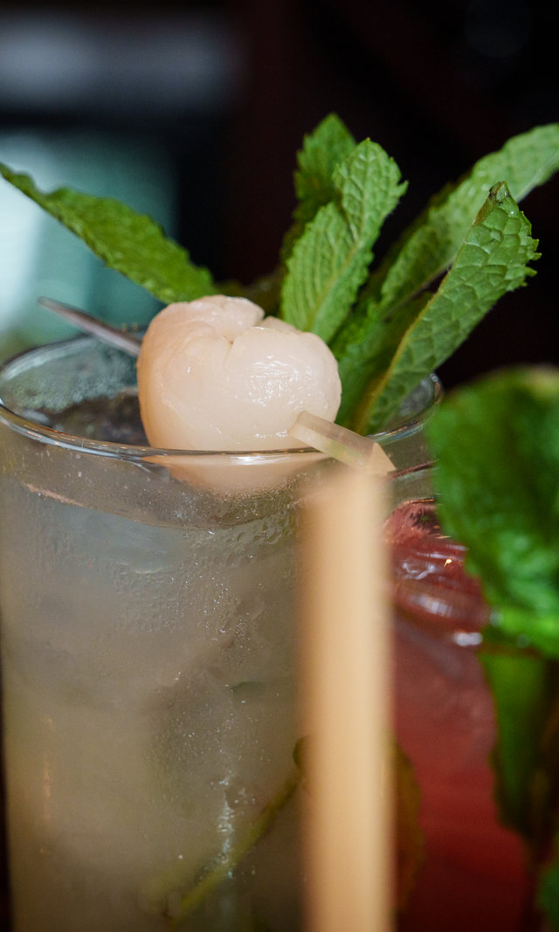
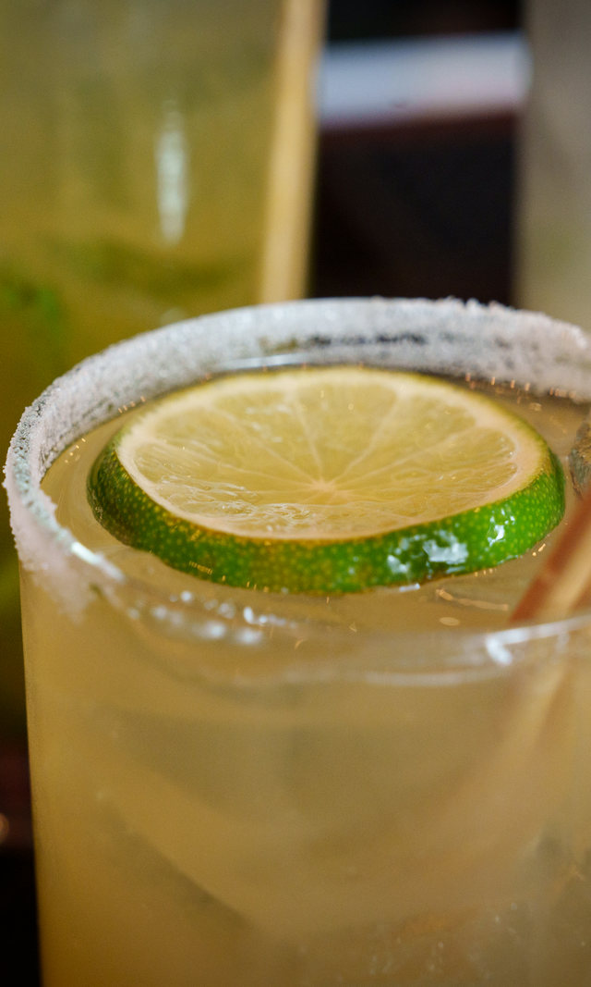
MENU IMAGERY
Cocktail photography made the bar program feel intentional and premium
Lighting, color, garnish, and environment were used to turn individual drinks into a coherent guest proposition.
CLASSIC SERVICE
COLOR STORY
SIGNATURE COCKTAIL
BAR ATMOSPHERE
SEASONAL DETAIL
PEDRO GOMEZ-FACCIO / MARKETING PORTFOLIO
13
Notes:
[Sources]
- /Users/faccio/Desktop/Portfolio/BackyardKitchenandBar_2023-02.jpg
- /Users/faccio/Desktop/Portfolio/BackyardKitchenandBar_2023-18.jpg
- /Users/faccio/Desktop/Portfolio/BackyardKitchenandBar_2023-24.jpg
- /Users/faccio/Desktop/Portfolio/BackyardKitchenandBar_2023-26.jpg
- /Users/faccio/Desktop/Portfolio/BackyardKitchenandBar_2023-27.jpg

Slide 14
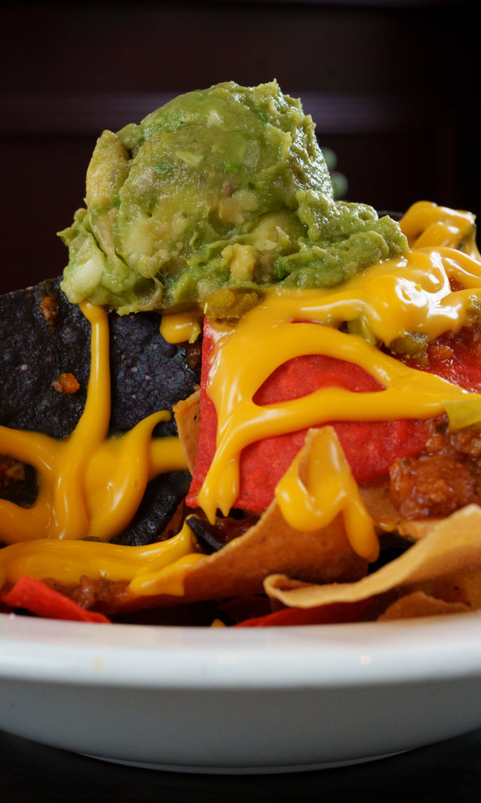
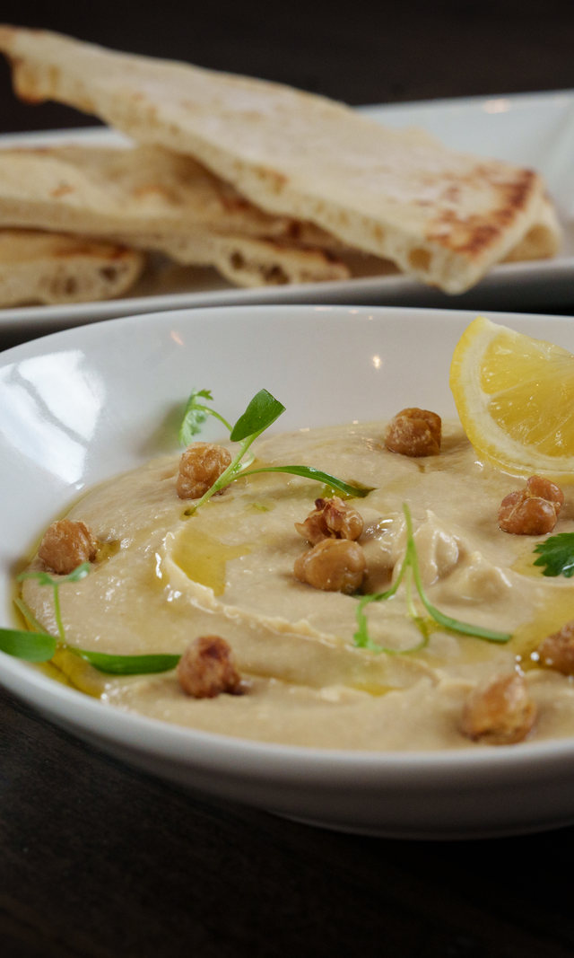
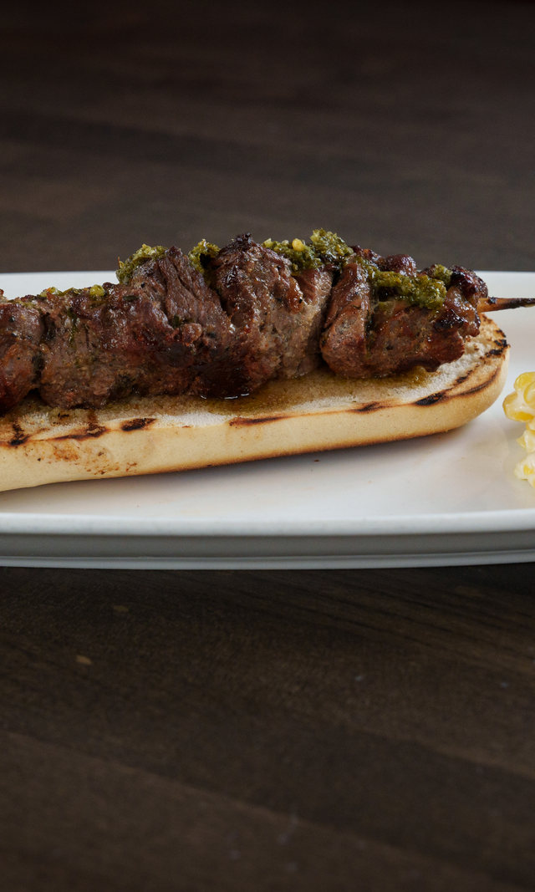
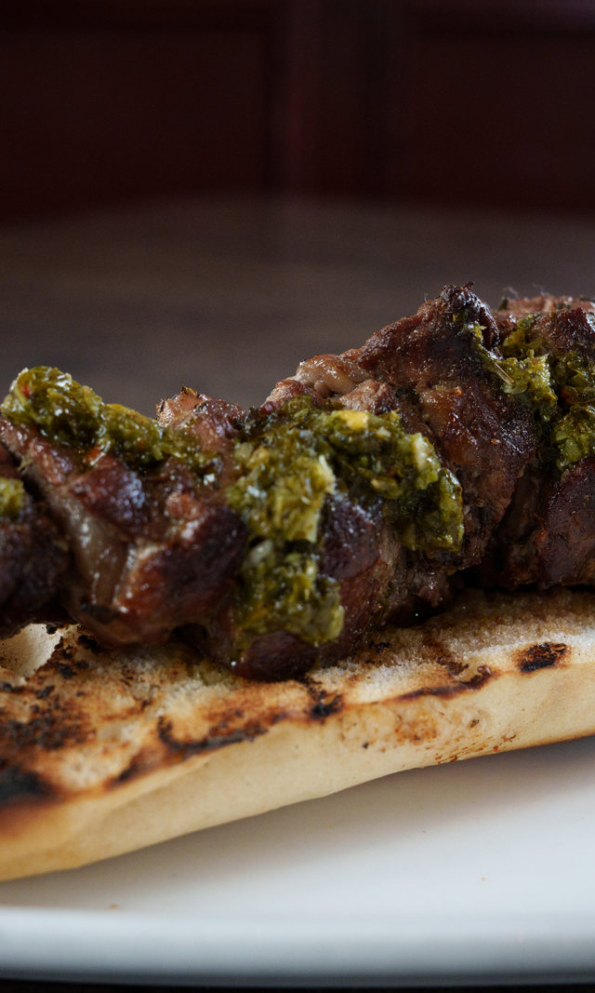
MENU IMAGERY
Food photography translated menu breadth into appetite and clarity
Different categories were given enough visual range to support social content, web merchandising, and menu launches without losing the brand voice.
SHAREABLE PLATE
CHEF DETAIL
FRESH PRESENTATION
GRILL STORY
SIGNATURE BURGER
PEDRO GOMEZ-FACCIO / MARKETING PORTFOLIO
14
Notes:
[Sources]
- /Users/faccio/Desktop/Portfolio/BackyardKitchenandBar_2023-48.jpg
- /Users/faccio/Desktop/Portfolio/BackyardKitchenandBar_2023-52.jpg
- /Users/faccio/Desktop/Portfolio/BackyardKitchenandBar_2023-56.jpg
- /Users/faccio/Desktop/Portfolio/BackyardKitchenandBar_2023-59.jpg
- /Users/faccio/Desktop/Portfolio/BackyardKitchenandBar_2023-69.jpg

Slide 15
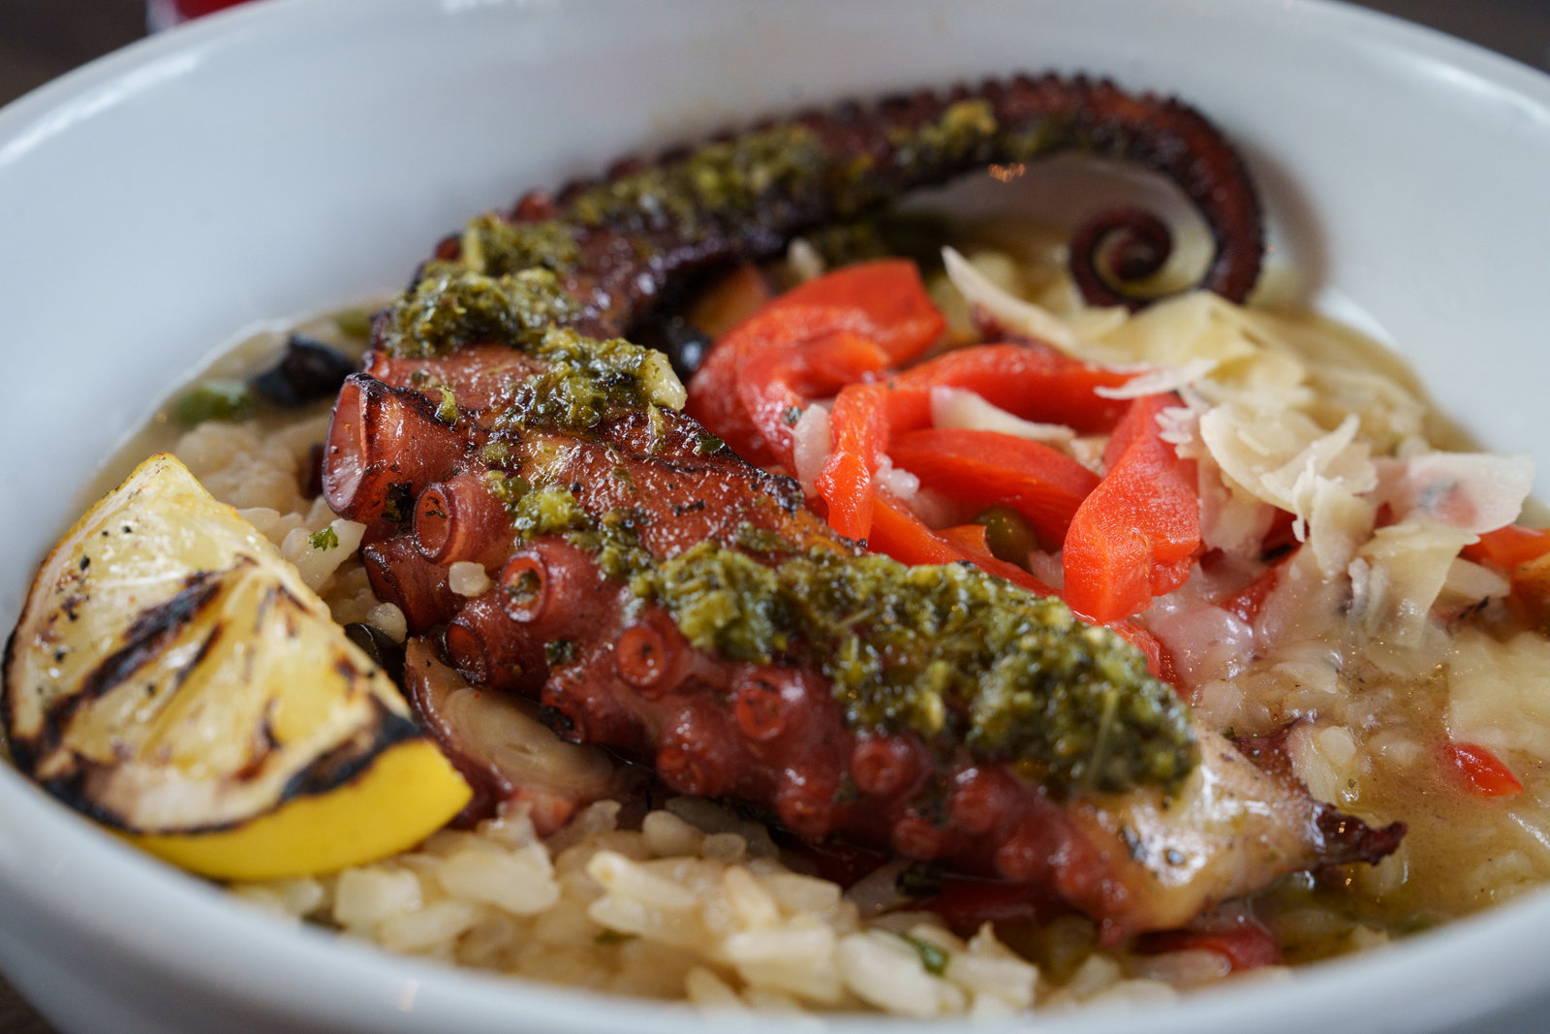
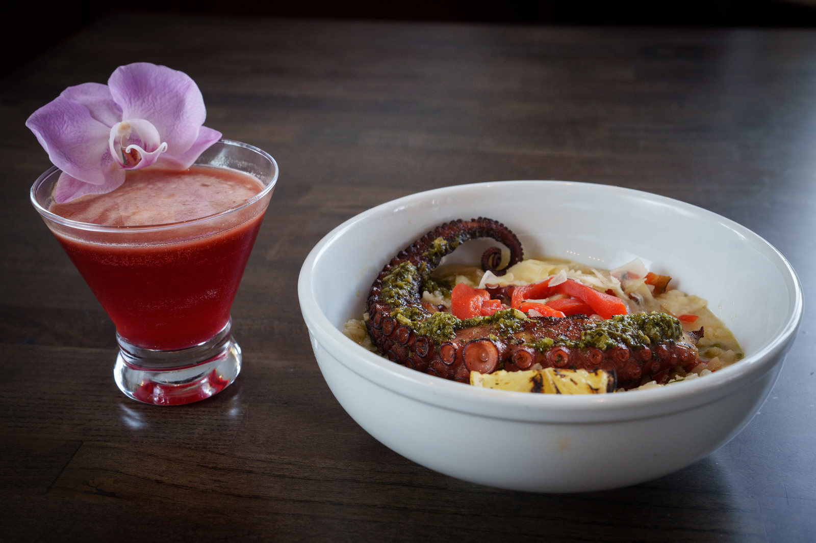
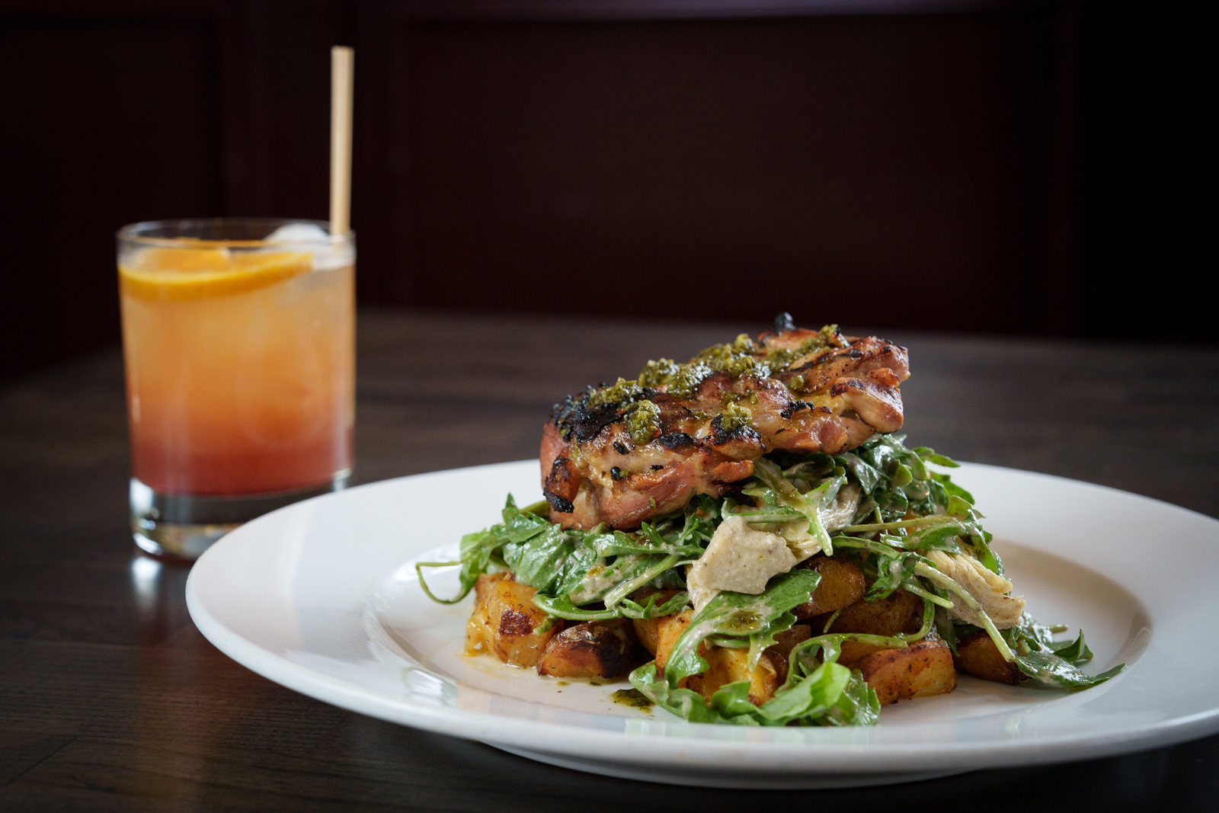
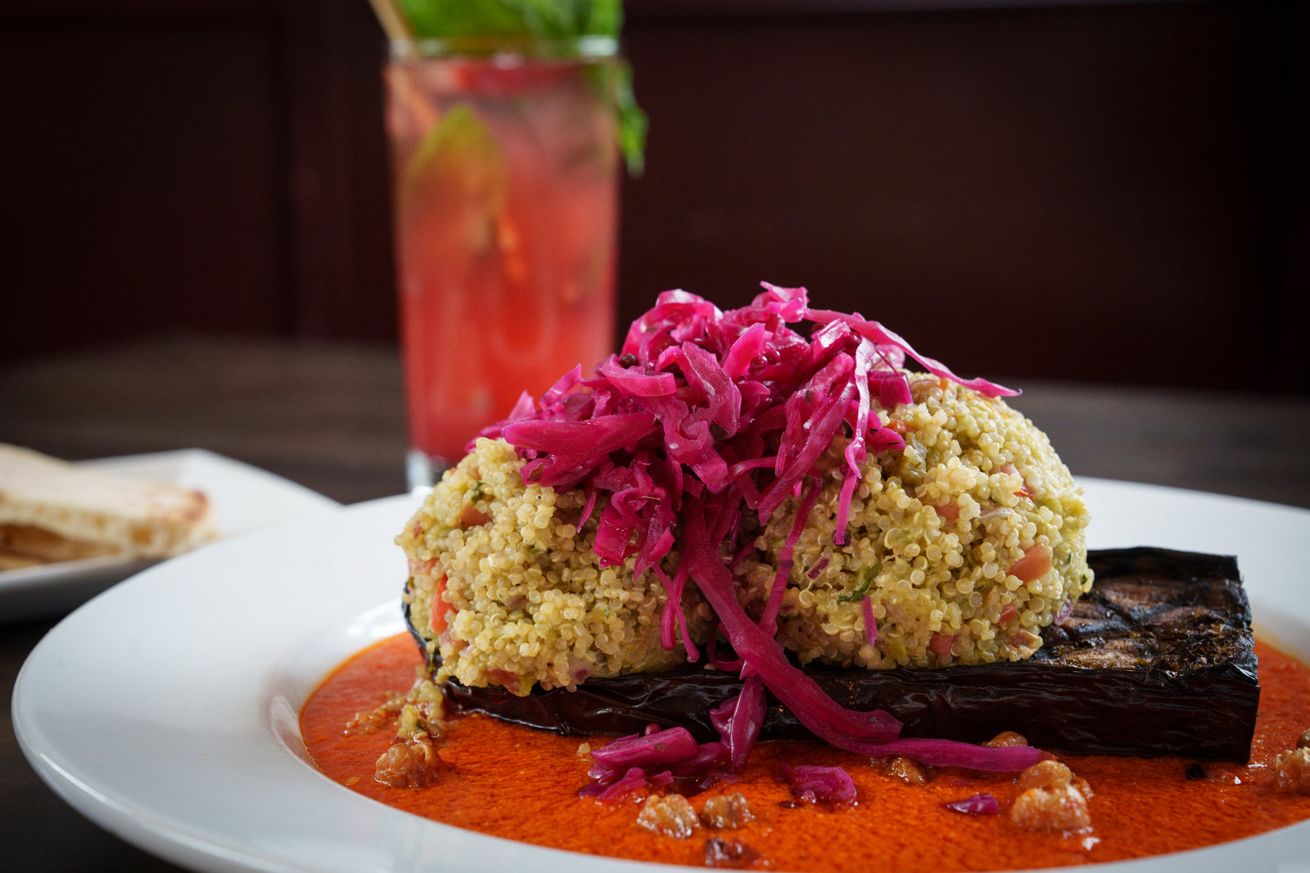
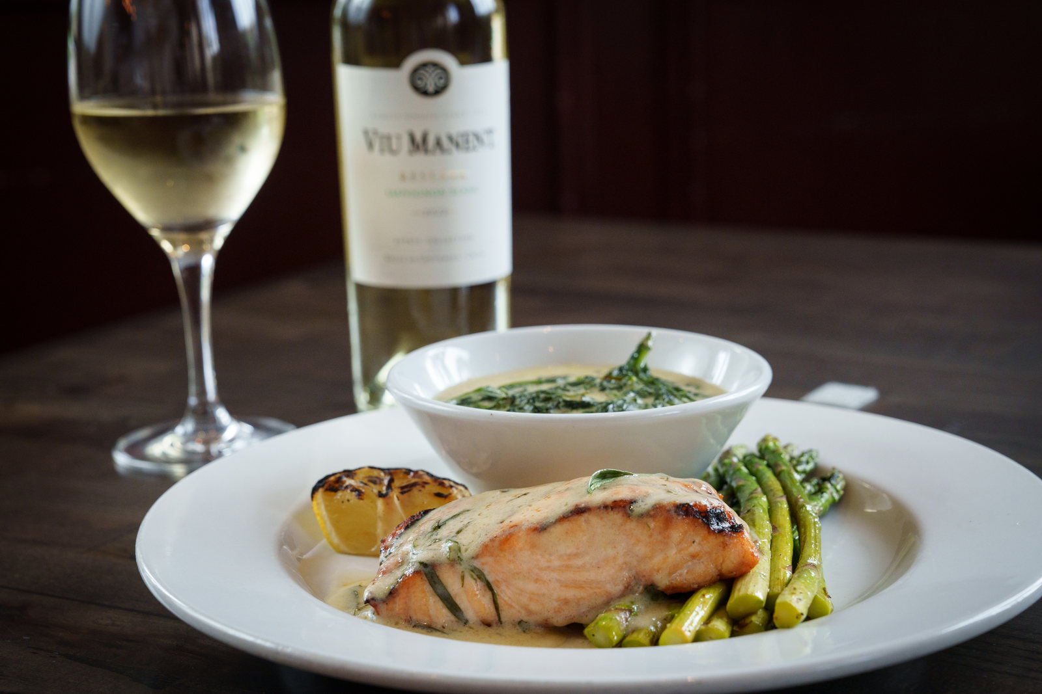
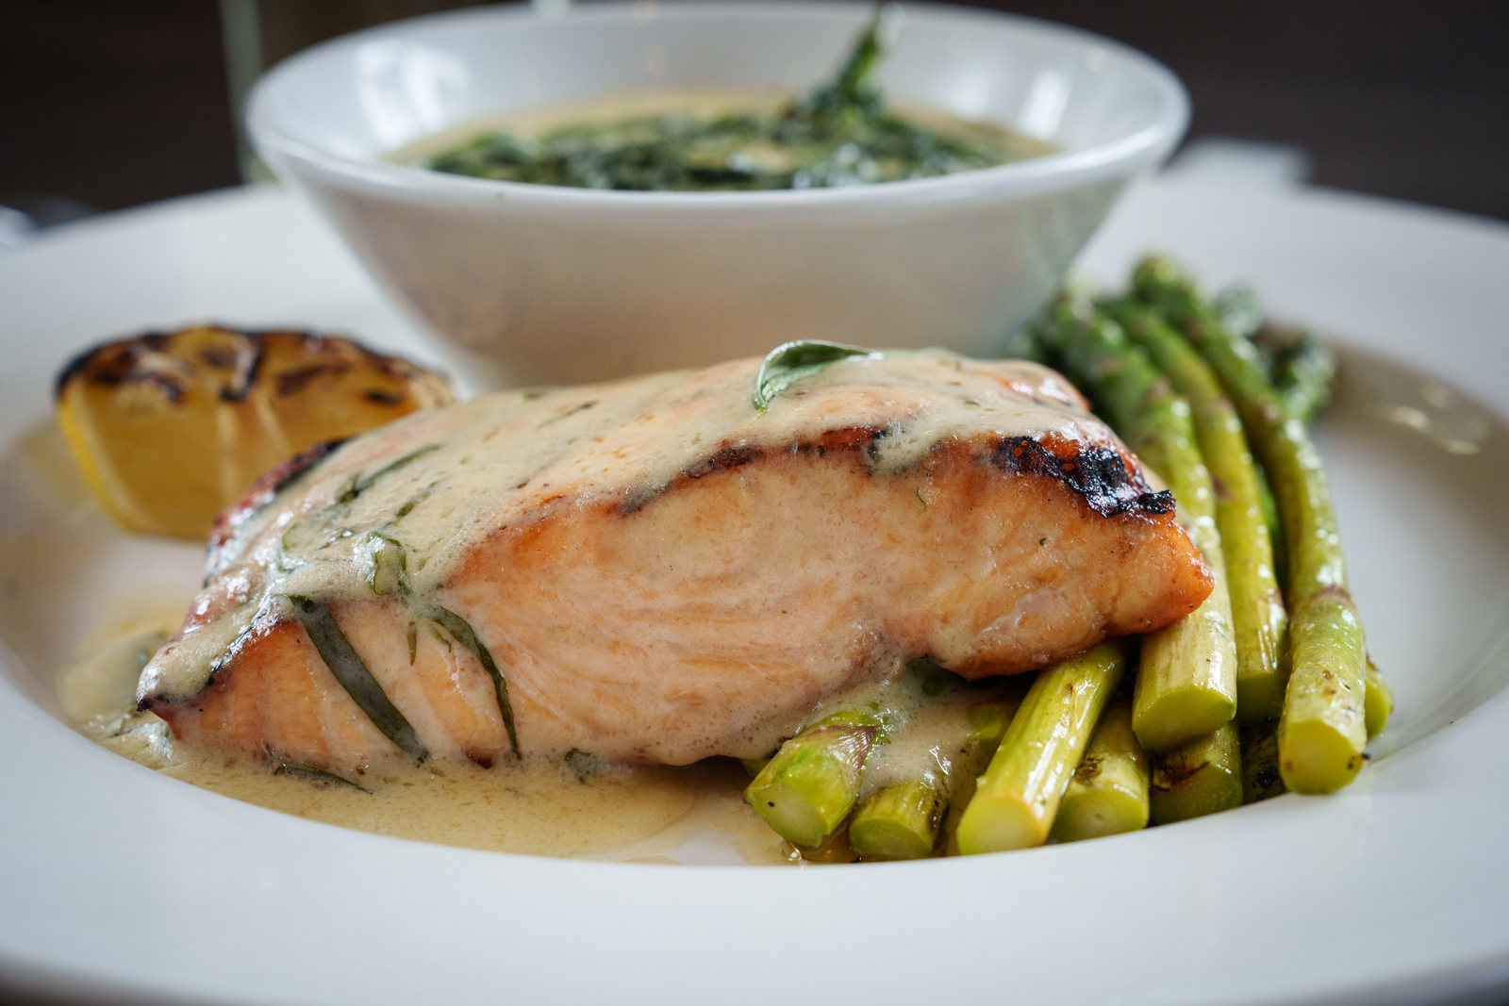
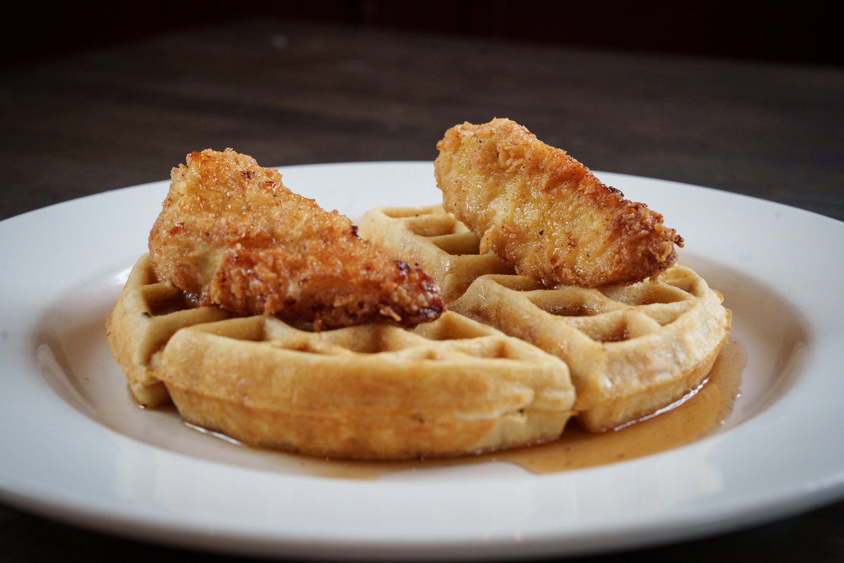
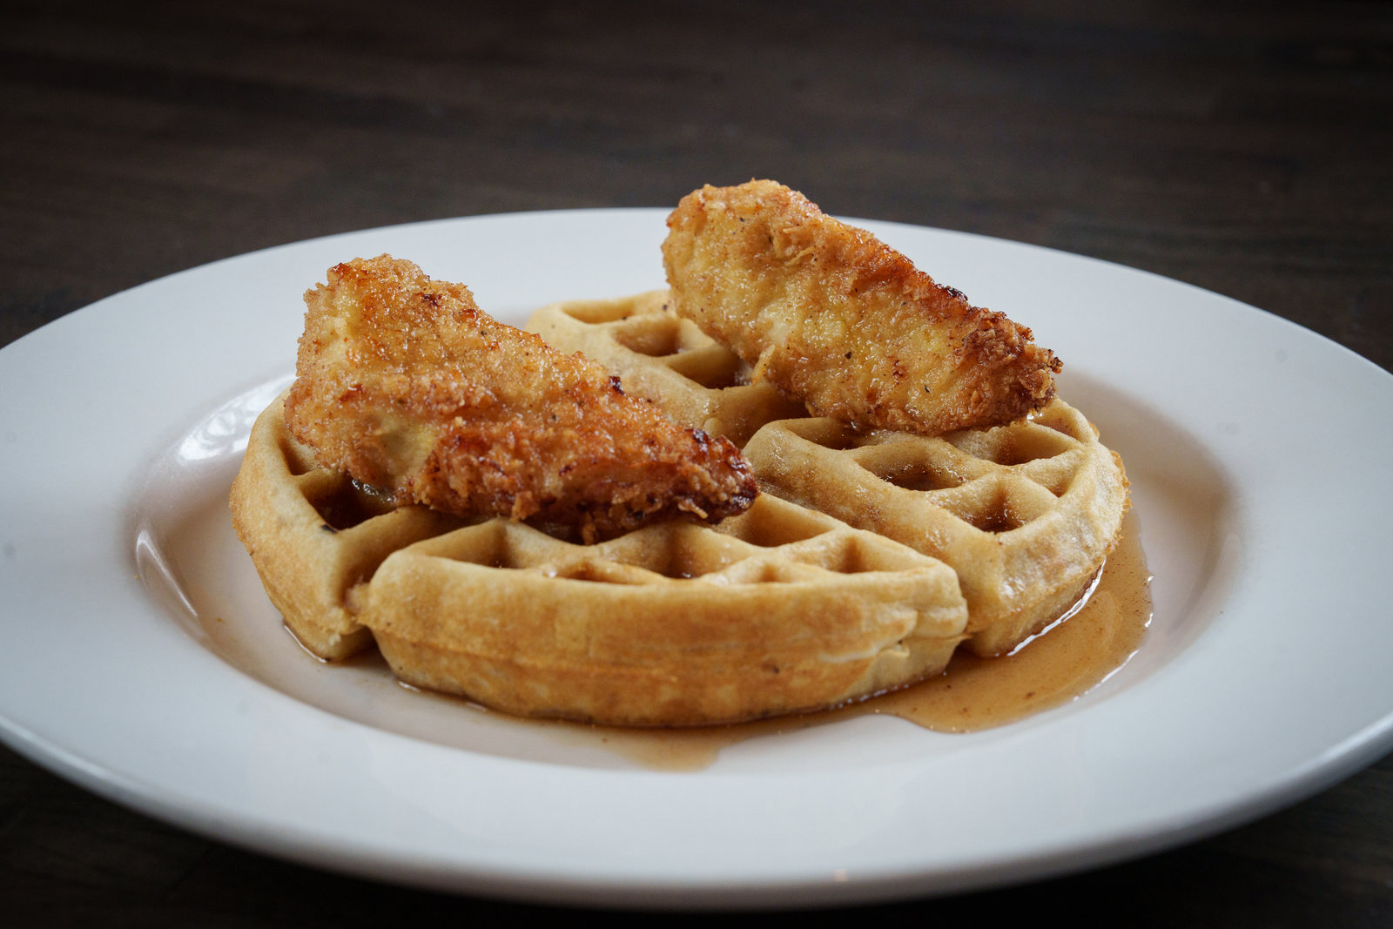
MENU IMAGERY
Entrées and occasion-led menu content supported both discovery and conversion
The photography system carried from everyday menu items into brunch and special-event merchandising.
ENTRÉE
BRUNCH
CHEF PLATE
SEASONAL
COMFORT
GRILL
WINE
DESSERT
OCCASION
PEDRO GOMEZ-FACCIO / MARKETING PORTFOLIO
15
Notes:
[Sources]
- /Users/faccio/Desktop/Portfolio/BackyardKitchenandBar_2023-95.jpg
- /Users/faccio/Desktop/Portfolio/BackyardKitchenandBar_2023-96.jpg
- /Users/faccio/Desktop/Portfolio/BackyardKitchenandBar_2023-119.jpg
- /Users/faccio/Desktop/Portfolio/BackyardKitchenandBar_2023-147.jpg
- /Users/faccio/Desktop/Portfolio/BackyardKitchenandBar_2023-160.jpg
- /Users/faccio/Desktop/Portfolio/BackyardKitchenandBar_2023-161.jpg
- /Users/faccio/Desktop/Portfolio/BackyardKitchenandBar_2023-181.jpg
- /Users/faccio/Desktop/Portfolio/BackyardKitchenandBar_2023-203.jpg
- /Users/faccio/Desktop/Portfolio/BackyardKitchenandBar_2023-204.jpg

Slide 16
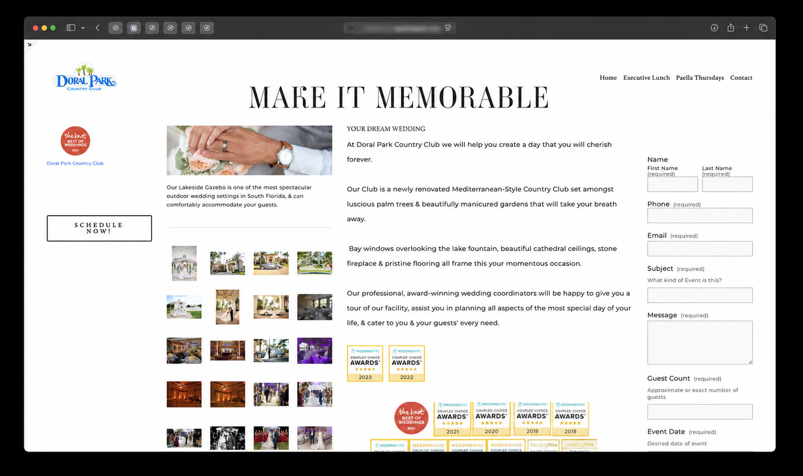
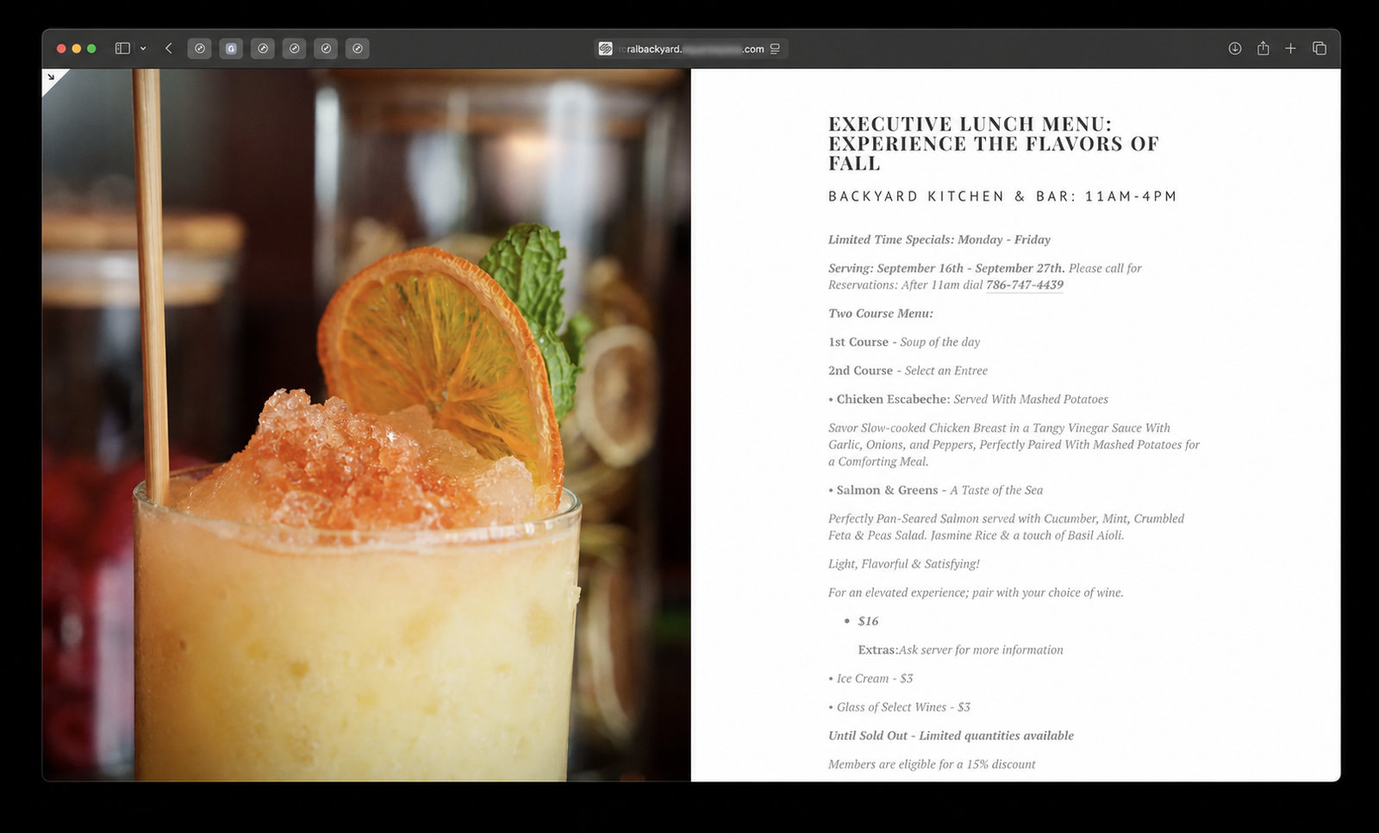
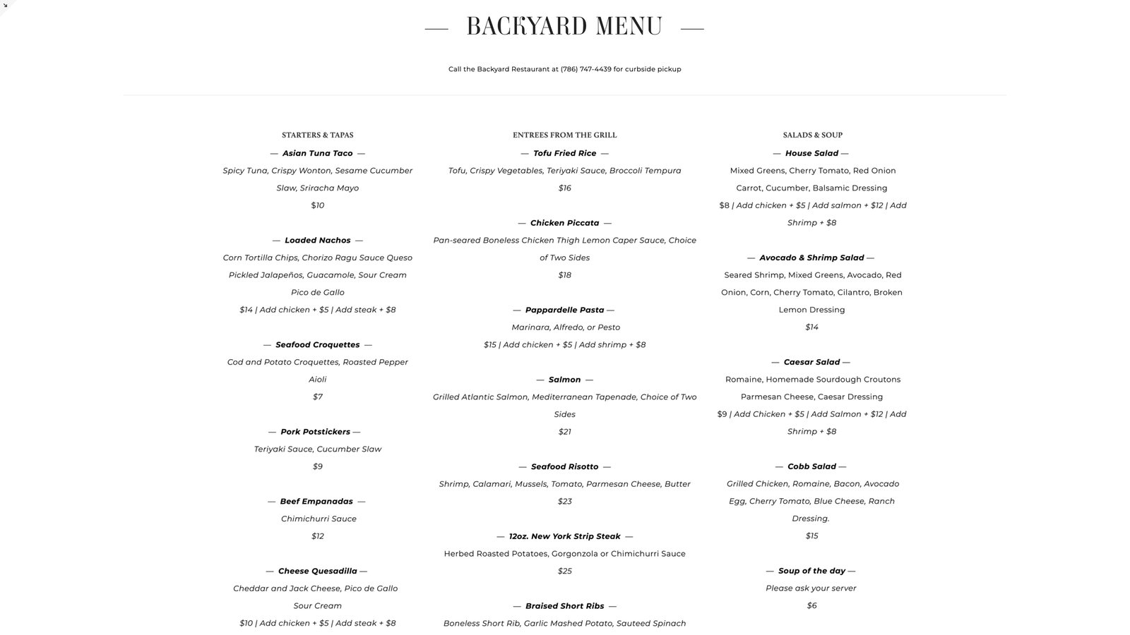
DIGITAL MENU EXPERIENCE
Menu content was designed to work where guests actually make decisions
Event, lunch, and menu experiences were carried into responsive digital pages with platform identifiers removed from the imagery.
EVENTS AND WEDDINGS
EXECUTIVE LUNCH
MENU EXPERIENCE
PEDRO GOMEZ-FACCIO / MARKETING PORTFOLIO
16
Notes:
[Sources]
- /Users/faccio/Desktop/Portfolio/tmp/rebuild_assets/web/weddings-sanitized.png — Squarespace domain blurred
- /Users/faccio/Desktop/Portfolio/tmp/rebuild_assets/web/executive-lunch-sanitized.png — Squarespace domain blurred
- /Users/faccio/Desktop/Portfolio/Screenshot 2026-07-24 at 11.19.34 AM.png — user-provided menu screenshot

Slide 17
DIGITAL SYSTEMS
Platform fluency with custom execution when the business needs more
The goal is not to force every requirement into one platform — it is to choose the right operating layer and deliver a maintainable result.
Squarespace Partner
Oracle systems
Experience structuring and delivering polished, editable web experiences.
Implementation experience connecting operational needs to enterprise systems.
Custom HTML + JavaScript
Python solutions
Purpose-built interfaces, integrations, and front-end behavior when needed.
Automation, analysis, reporting, and data workflows beyond standard platform limits.
PEDRO GOMEZ-FACCIO / MARKETING PORTFOLIO
17
Notes:
[Sources]
- User-provided professional capability statement
- /Users/faccio/Desktop/Portfolio/tmp/rebuild_assets/web/weddings-sanitized.png and executive-lunch-sanitized.png — platform domain removed from screenshots

Slide 18
RECENT BUSINESS CONSULT AND REVIEW
Bombay Darbar: five revenue gaps turned into an actionable growth agenda
A recent business consultation and review for the acclaimed three-location South Florida Indian restaurant group connected demand, conversion, and operating economics.
5
$24K–$72K
EN / ES
REVENUE GAPS DIAGNOSED
MONTHLY NO-SHOW EXPOSURE
BILINGUAL DELIVERY
A focused review of leakage between attention, booking, and realized revenue
A modeled range used to frame the size of the opportunity
A concise business review designed for operational use
RECOMMENDED COMMERCIAL ARCHITECTURE
Offline-to-online conversion architecture
No-show recovery and reservation protection
Premium-brand offer strategy tied to measurable outcomes
PEDRO GOMEZ-FACCIO / MARKETING PORTFOLIO
18
Notes:
[Sources]
- User-provided reference portfolio, page 18
- Positioned as a recent business consultation and review; no signed engagement is claimed

Slide 19
RECENT PRESENTATION FOR UBER
Marketplace performance diagnosis: strong economics, constrained discovery
The presentation separated what was already working from the feed-position and acquisition constraints limiting scale.
$25,505
1,192
640
COMBINED SALES
ORDERS
NEW CUSTOMERS
Current-state total across the reviewed locations
Order volume supporting the marketplace assessment
Acquisition volume within the reviewed period
CORE CONCLUSION
Average basket value was healthy at $21.68, but feed positions of 14 / 21 / 21 limited efficient discovery. The recommended plan paired stronger placement with evidence-led offers instead of indiscriminate discounting.
PEDRO GOMEZ-FACCIO / MARKETING PORTFOLIO
19
Notes:
[Sources]
- /Users/faccio/Desktop/Portfolio/output/Presentation for Uber Client.pdf — combined sales, orders, new customers, average basket, and feed positions

Slide 20
RECENT PRESENTATION FOR UBER
Historical evidence set the investment logic; projections defined the next test
Past results and forward targets are kept explicitly separate so the recommendation remains credible.
5.95x
4.24x
$33K–$36K
HISTORICAL COMBINED ROAS
HISTORICAL BOGO ROAS
PROJECTED SALES TARGET
$1,600 sponsored-ad spend produced $9,520 in attributed sales
Prior offer evidence supporting an efficient acquisition hypothesis
Forward target, not a reported result
NEXT-TEST TARGETS
950–1,100 projected new customers
Top 5–8 target feed position
Investment increased only when placement and unit economics support it
PEDRO GOMEZ-FACCIO / MARKETING PORTFOLIO
20
Notes:
[Sources]
- /Users/faccio/Desktop/Portfolio/output/Presentation for Uber Client.pdf — historical ROAS evidence and forward targets
- Projection labels added to distinguish targets from documented results

Slide 21
RECENT PRESENTATION FOR OPENTABLE
Booking-source shifts revealed a quality-of-demand problem, not a traffic problem
The assessment reframed year-over-year channel changes into a retention, contribution, and inventory-control question.
Out of town
+33.1%
Phone
+7.1%
OpenTable
-2.2%
Walk-in
-5.0%
Full book
-8.7%
Last minute
-10.0%
First time
-12.8%
RestRef
-56.7%
CURRENT MARCH VS PRIOR MARCH
PEDRO GOMEZ-FACCIO / MARKETING PORTFOLIO
21
Notes:
[Sources]
- /Users/faccio/Desktop/Opentable Assesment/Scenario.png
- /Users/faccio/Desktop/Opentable Assesment/Instructions.png
- /Users/faccio/Desktop/Opentable Assesment/Instructions copy.png

Slide 22
RECENT PRESENTATION FOR OPENTABLE
The recommendation protected local loyalty while monetizing visitor demand
The answer was not to reject demand — it was to manage inventory, segment customers, and judge channels by contribution and lifetime value.
01
Protect local repeats
02
Monetize visitor demand
Reserve a controlled share of inventory for repeat local guests.
Use shoulder times, deposits, waitlist, and pacing to capture high-intent traffic.
03
Segment the database
04
Measure contribution
Build distinct messaging and reactivation paths for visitor, local, and repeat cohorts.
Evaluate profit and lifetime value — not just the source of the cover.
PEDRO GOMEZ-FACCIO / MARKETING PORTFOLIO
22
Notes:
[Sources]
- /Users/faccio/Desktop/Opentable Assesment/Scenario.png
- Strategy recommendations derived from the supplied OpenTable assessment scenario

Slide 23
PEDRO GOMEZ-FACCIO
Premium creative.
Commercial discipline.
Measurable outcomes.
MARKETING LEADERSHIP
Brand and campaign systems
Property and hospitality storytelling
Digital experience and systems implementation
Marketplace growth and commercial analytics
Client partnership from strategy through launch
Editable presentation · embeddable web portfolio · supporting reports included
Notes:
[Sources]
- Closing synthesis based on the portfolio evidence

